Slide 1
EXCEL FINAL ASSESSMENT
YAMUNA V
LVADSUSR199
2/4/2024

Slide 2
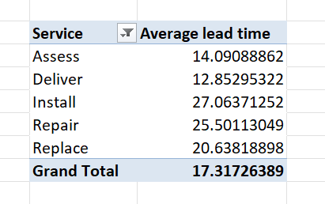
Question 1
The average lead time between the request date and completion date for all work orders is 17.31

Slide 3
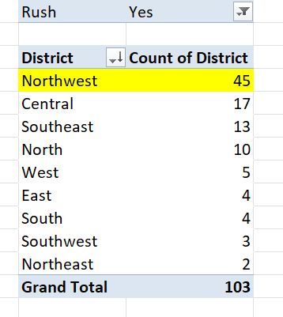
Question 2
Northwest has highest number of rush jobs

Slide 4
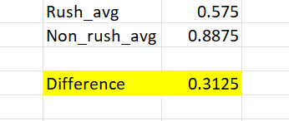
Question 3
The difference in average labour hours between rush and non rush jobs is 0.3125 hrs

Slide 5
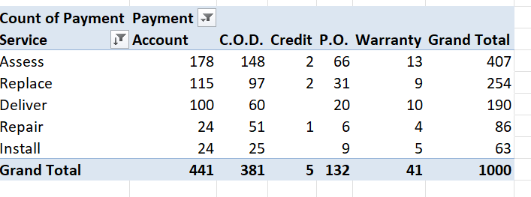
Question 4
The distribution of payment types across different services
Assess service has highest account type payment

Slide 6
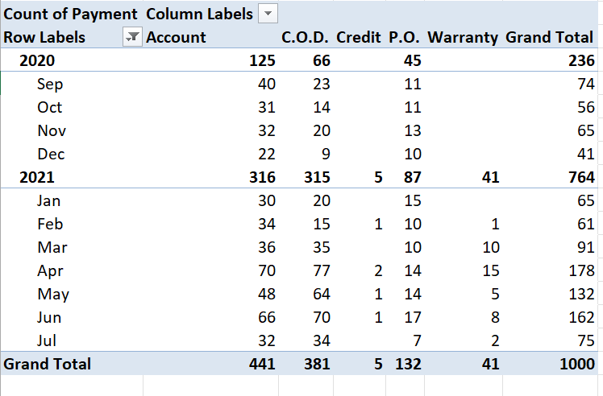
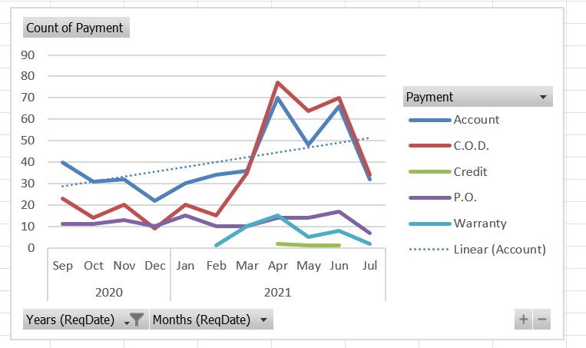
Question 5
Trends in distribution of payments over time
Account and COD payment increases
P.O. and warranty payment decreases

Slide 7
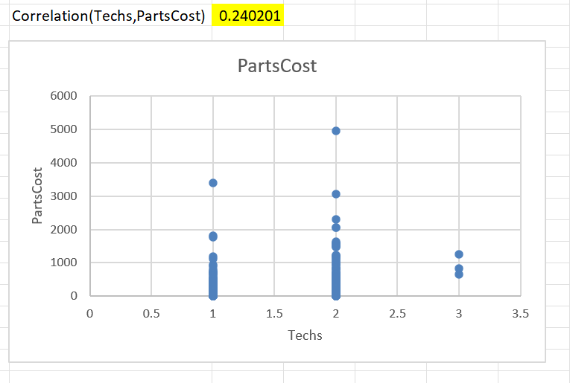
Question 6
Relationship between number of technicians required and the cost of parts
The number of technicians required and the cost of parts shows positive correlation value of 0.24
The scatter plot shows the Relationship between number of technicians required and the cost of parts

Slide 8
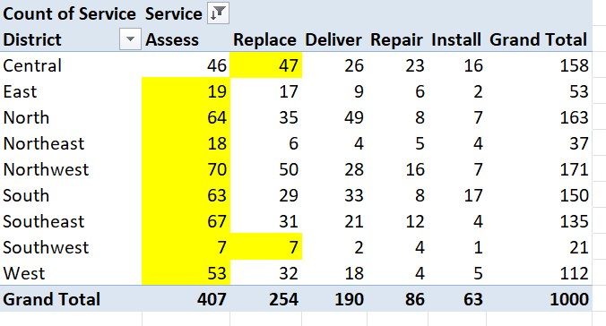
Question 7
The most common type of service in each district is highlighted in the table below

Slide 9
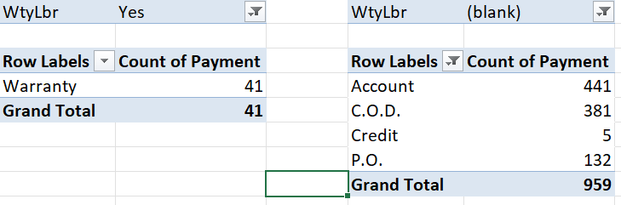
Question 8
The difference in the distribution of payment types for work orders with warranty labour compared to those without is as in the table below
Warranty payment for work orders with warranty labour
Account, C.O.D, Credit, P.O. payments for work orders without warranty labour
Therefore there is a difference in the distribution of payment types for work orders with warranty labour compared to those without

Slide 10
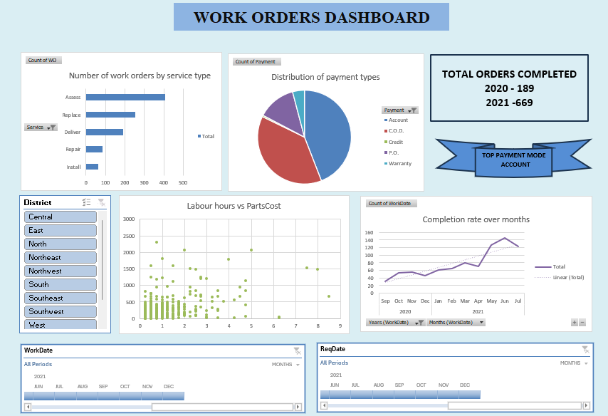
Question 9 - Dashboard

Slide 11
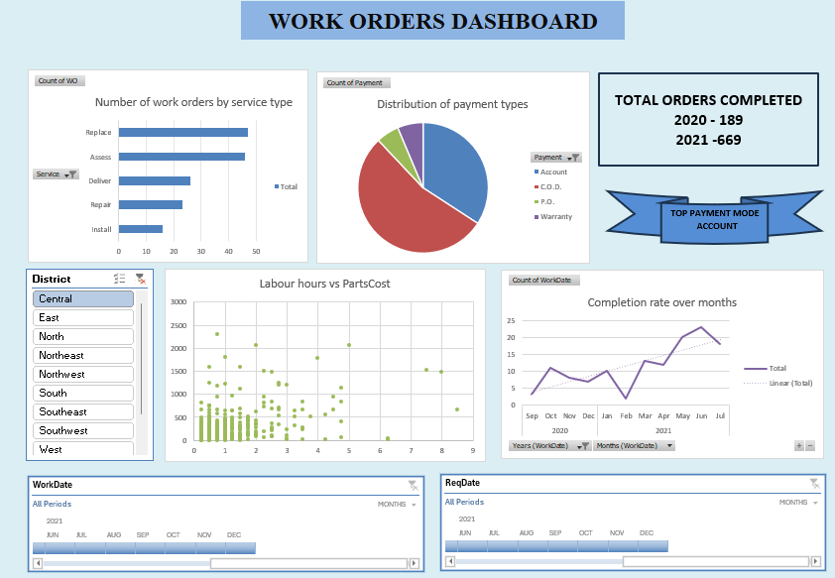
For region – central

Slide 12
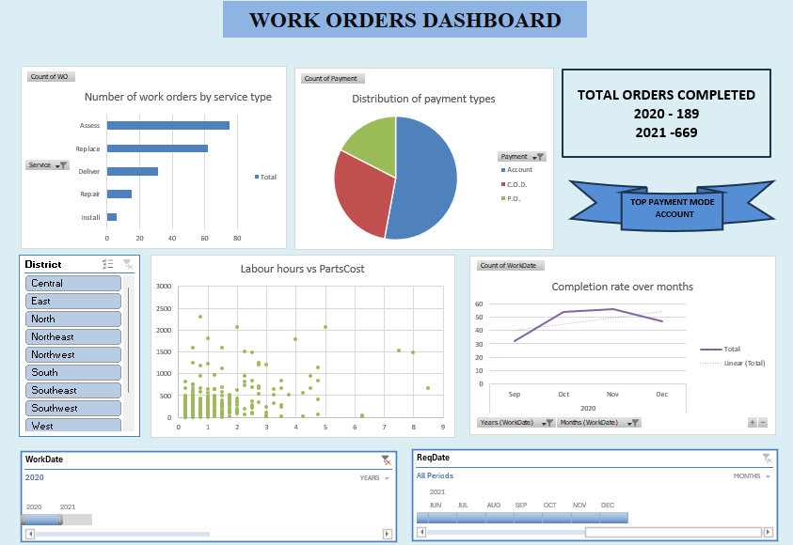
For WorkDate in year 2020

